Slide 1
AIR LINE RESERVATION SYSTEM
SUBMITED TO :- SUBMITED BY:-
MUTHU GANESH SIR MOHD.MAZIN(23SCSE1011035)
AMAN PAL (23SCSE1011511)
SHARIM SALMAN(23SCSE10123307)
ABHISHEK KUMAR(23SCSE1011297)

Slide 2
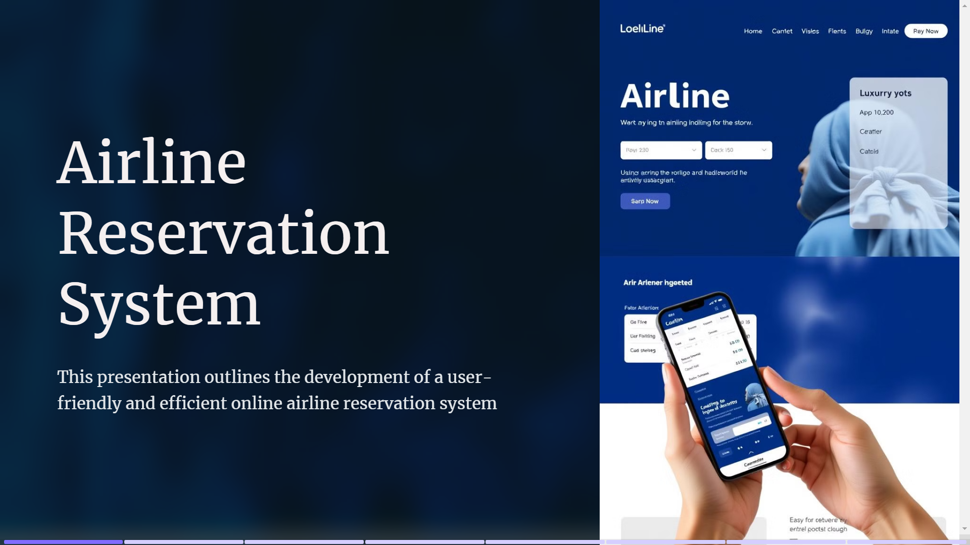

Slide 3
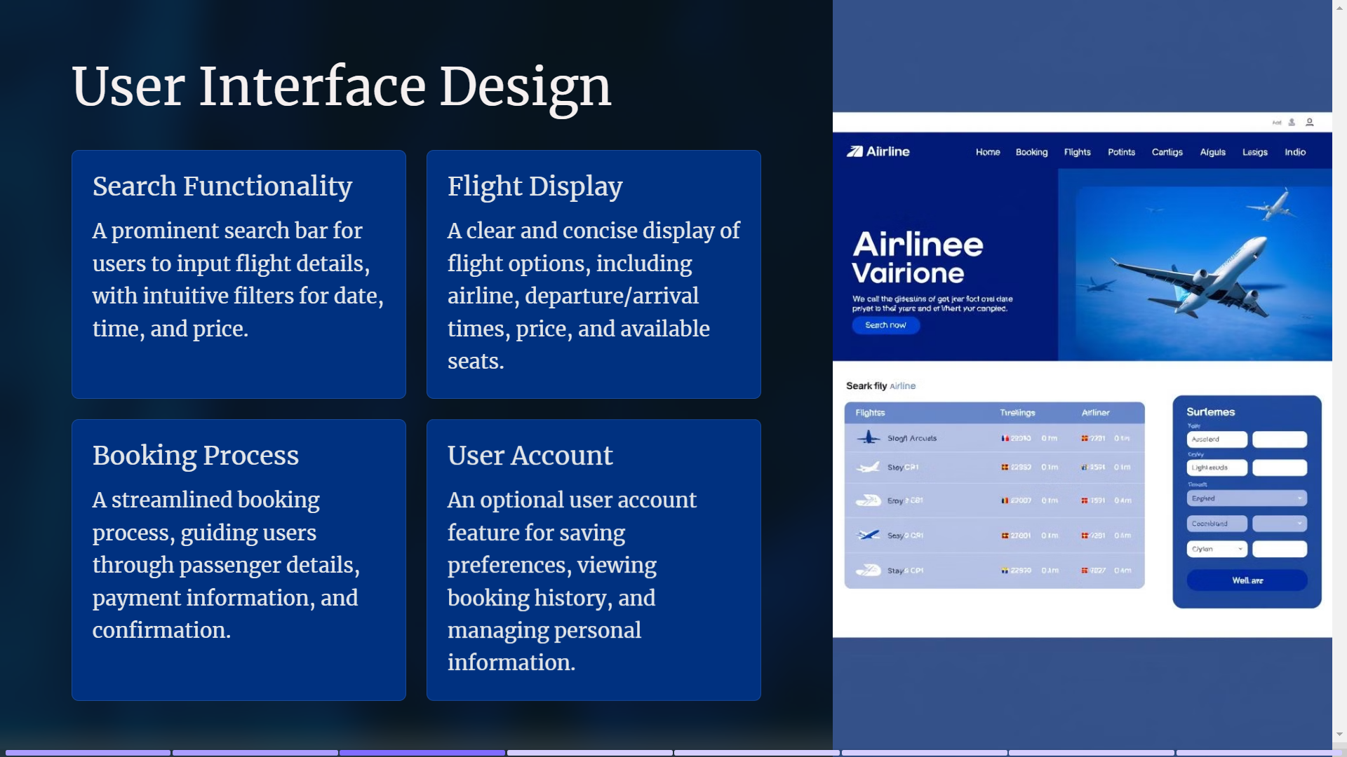

Slide 4
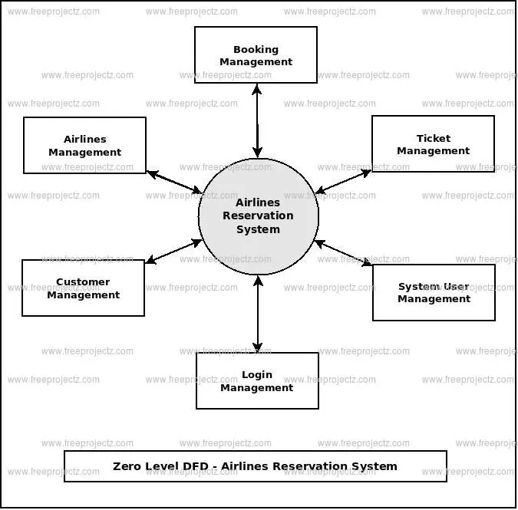
…..FLOW CHART…..

Slide 5
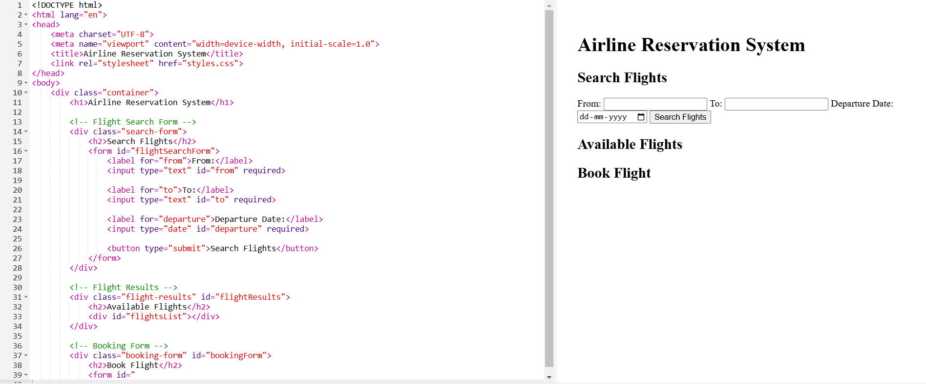
…FROANTEND CODE…

Slide 6
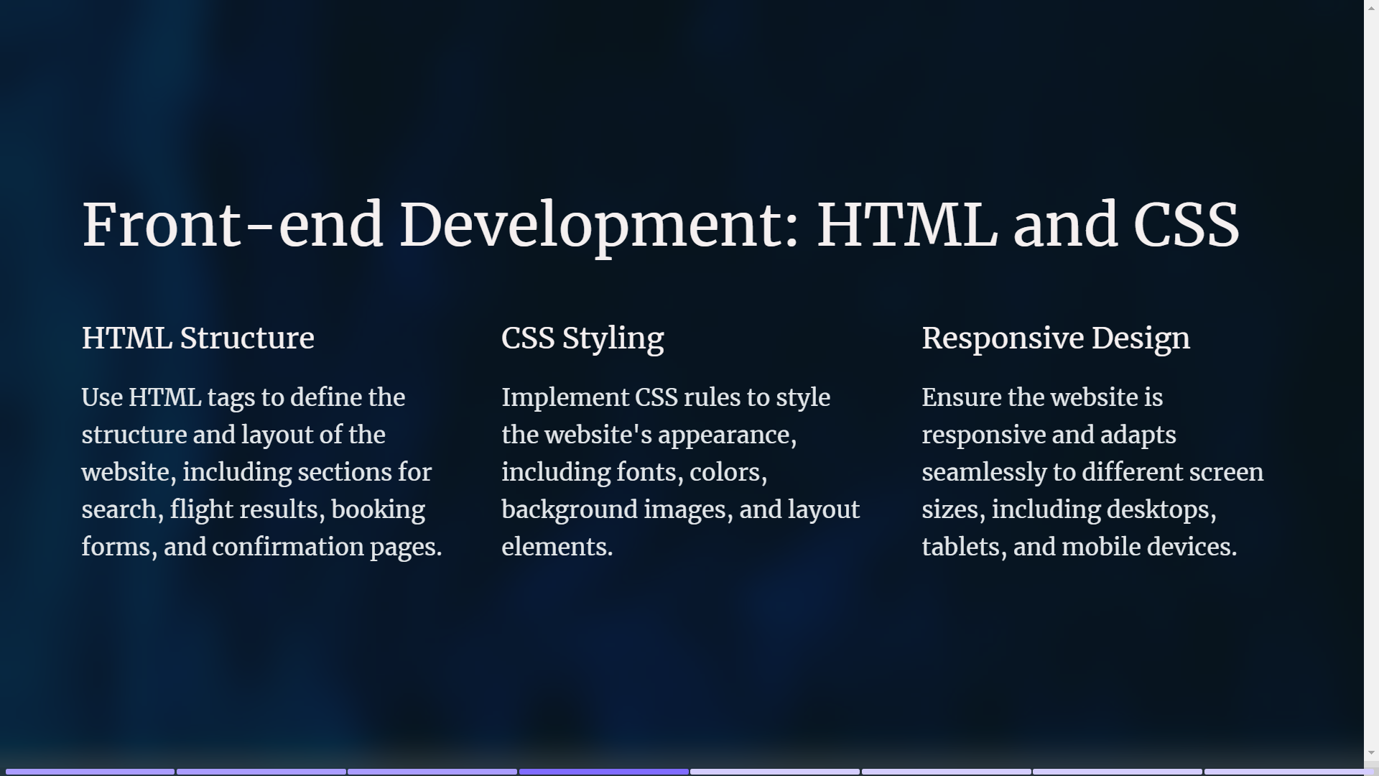

Slide 7
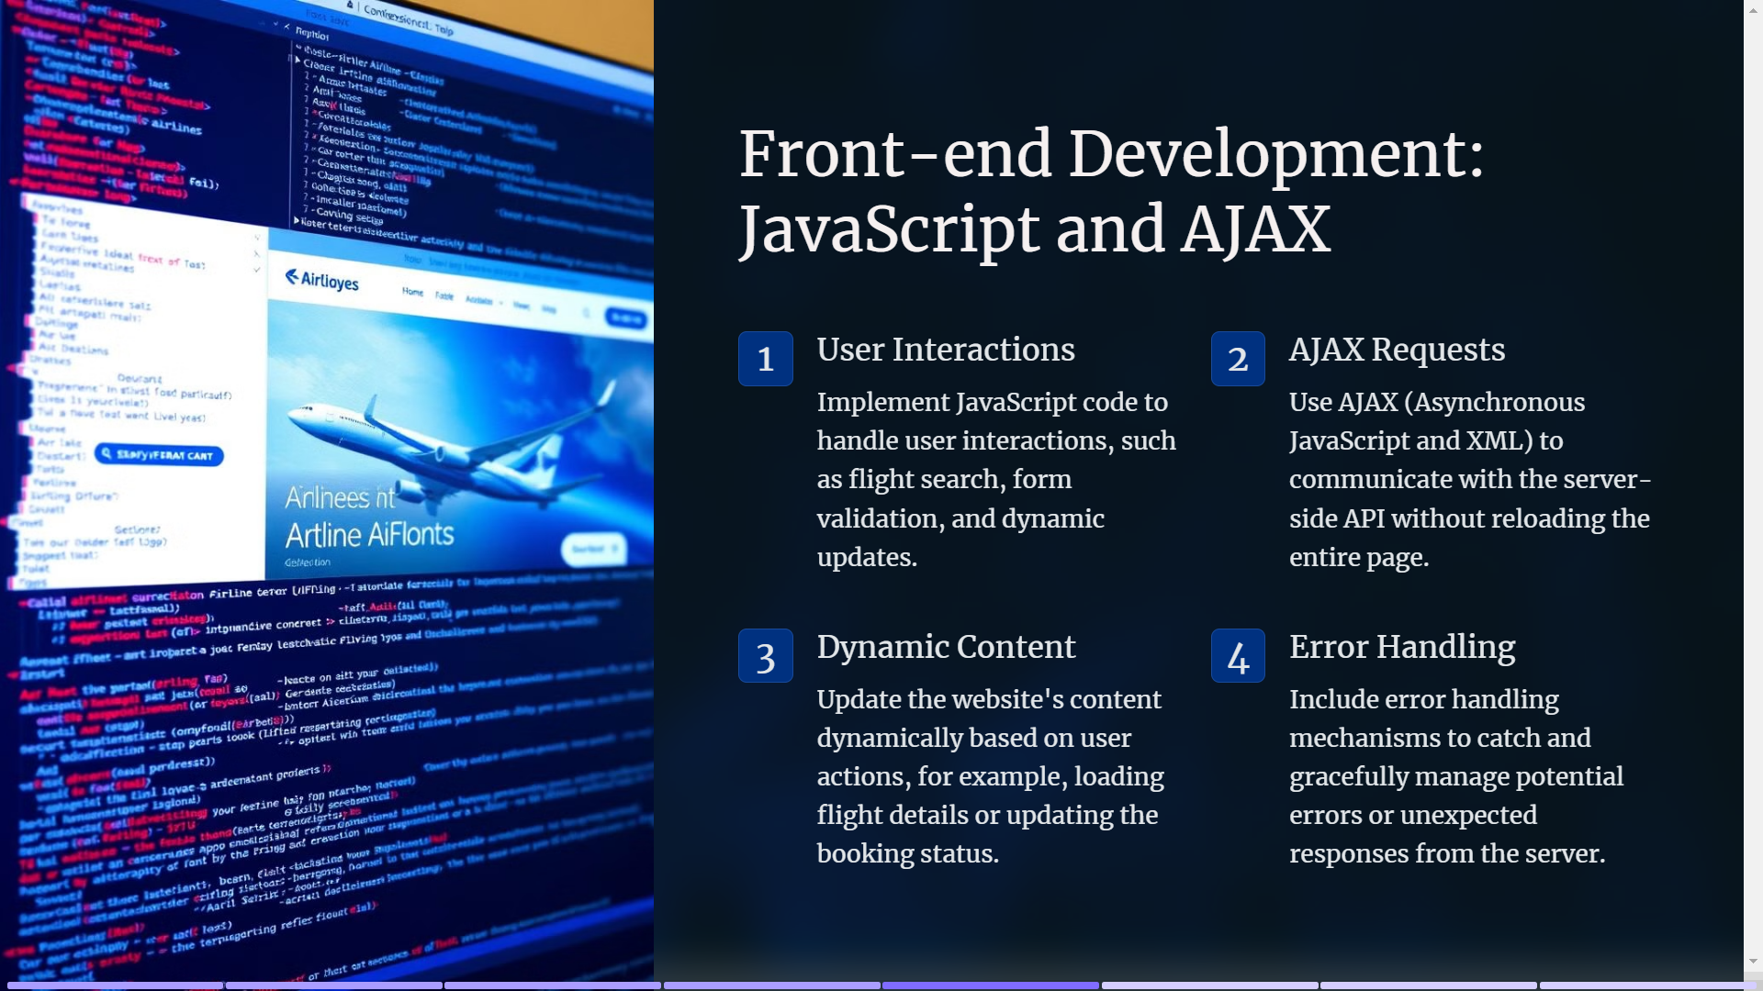

Slide 8
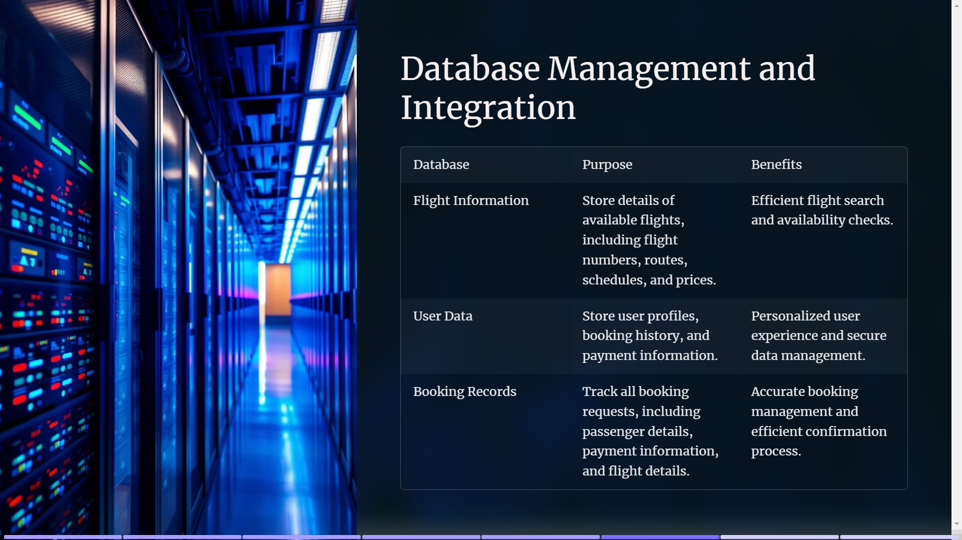

Slide 9


Slide 10


